Slide 1

Simple Phishing URL detection Using Machine Learning and NLP technology
Supervised by
Aminun Nahar
Assistant Professor
Dept. Of CSE, IUBAT
Prepared by
MD. Shariful Islam Bhuyan
Program- BCSE
ID- 20103209

Slide 2
Contents
Introduction
-Phishing techniques approaches
-Phishing detection approaches
-Problem statement
-Objectives
Literature review
Data source
Methodologies
Working flow
Results
Conclusion
Future Work

Slide 3
Introduction
Phishing is a fraudulent technique that uses social and technological tricks to steal customer identification and financial credentials.
According to APWG’s Phishing Activity Trends Report phishing attacks hit an all-time high in 2021. With more than 300,000 attacks recorded in December, these incidents have become more than three times as common as they were less than two years ago.

Slide 4
Phishing Techniques Approaches
SMS Phishing
Vishing
Social Engineering
Email Phishing
Phishing
Website
Malware
Key logger
Technical subterfuge
Web trojan
Pharming

Slide 5

Phishing detection approaches
List Based approach
Visual similarity
Content Based
Machine learning algorithm

Slide 6
Problem Statement
As we are becoming more dependent on online activity , the security of personal information is vital.
Detecting a phishing site is complex as the structure of phishing content is similar to the original content.
The phishing technique is getting updated over time, efficient anti-phishing approach also needed.

Slide 7
Objectives Of Research
Extracting the Key features of phishing URL.
To try different machine learning model to classify the URL is malicious or not.
To Develop a simple phishing detection System.

Slide 8
Literature Review 1
Title: “Phishing Website Detection Using Machine Learning Algorithms”
Author: Parvathy R.
Published Date: 21 September 2022.
Methods: Random Forest, Decision Tree, KNN, Logistic Regression, and
Support Vector Machine (SVM)
Result: the logistic Regression achieves 0.94 accuracy with 0.90 precision and 0.94 recall.
Limitation and scope: They used different APIs and Indexes from internet which need to be updated over time. This dependency can be solved.

Slide 9
Literature Review 2
Title: "NLP Based Phishing Attack Detection from URLs"
Author: Ebubekir Buber, Banu Diri and Ozgur Koray Sahingoz
Published Date: March 2018
Methodology: Hybrid testing with NLP features and word vectors.
Result: Random Forest gives best accuracy avobe 90%
Limitation and scope: Depending on few features and used a less amount of data.

Slide 10
Literature Review 3
Title: "Phishing Website Detection using Machine Learning
Algorithms"
Author: Rishikesh Mahajan, Irfan Siddavatam
Published Date: October 2018, International Journal of Computer Applications (0975 – 8887)
Methodology: SVM, Decision Tree, Random Forest
Result: They obtained 97% accuracy while using Random forest data classifier to process the URLs.
Limitation and scope: They used a dataset of 36,711 URLs. Increasing the size of data set cause huge delay in deploying Random forest algorithm.

Slide 11
Data source
Data set is collected from Kaggle.com
Containing 4 Lakhs Benign and 1 lakhs of good URL.

Slide 12
Methodologies
Load Dataset
Feature extraction
Logistic Regression
KNN
Decision Tree
MultinomialNB
Performance analysis
Chose the suitable classifier
Classifier
Load URL
Decision whether Phish or not

Slide 13
Working Procedure
Feature Extraction:
Dataset
Remove duplicate urls
Tokenization
Remove duplicate URLS
Tokenize the URL strings
Find rootwords
Combine rootwords
Data Labeling
URLs
regular expression
Make sentence
Finding root words
Snowball stemmer
Data labeling
Good
Bad

Slide 14
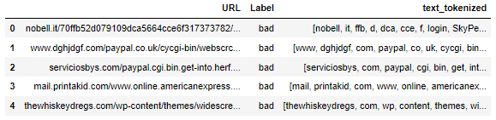
Feature Extraction (Contd)
Tokenized Data:

Slide 15
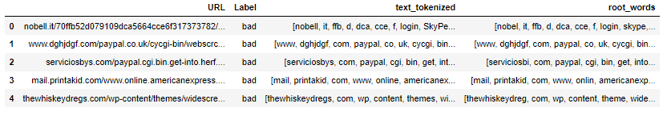
Feature Extraction (Contd)
Finding Root Words: By Snowball stemmer

Slide 16
Feature Extraction (contd)
Count Vectorizer:
Labelled data
Count vectorizer
For numerical representation of data
Tokenize the text and basic preprocessing.
Count frequently used word and make a column for each word and counting value.
Each of the subset represent a sparse matrix
unique URLs: 507196
unique words: 3,50,837
Split Data
Train/Test
Apply ML Algo.

Slide 17
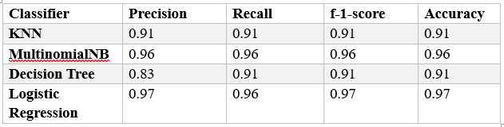
Result

Slide 18
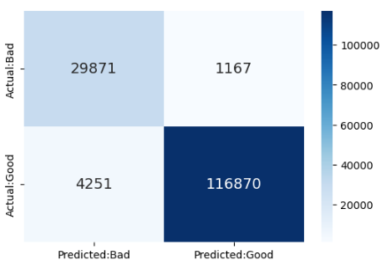
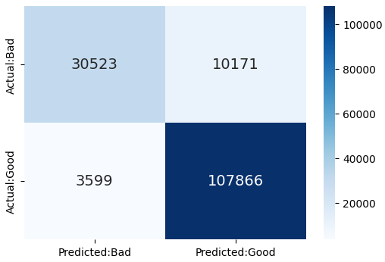
Confusion Matrix
KNN:
Logistic Regression:
TN
FP
Vs
FN
TP

Slide 19
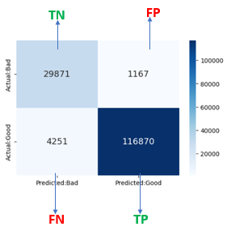
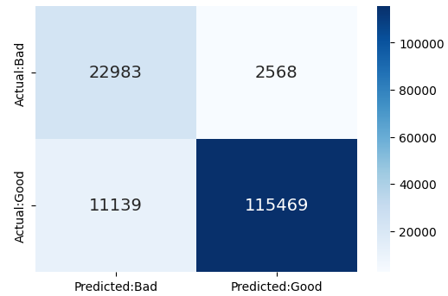
Confusion Matrix (contd)
Logistic Regression:
Decision Tree:
Vs

Slide 20
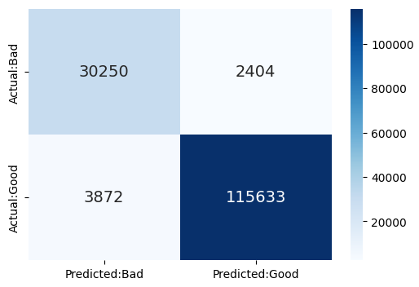
Confusion Matrix
MultinomialNB:
Logistic Regression:
Vs

Slide 21
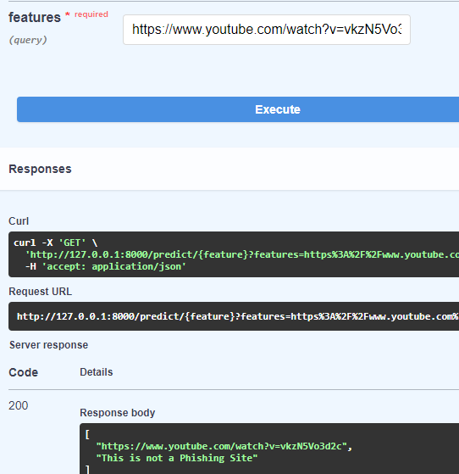
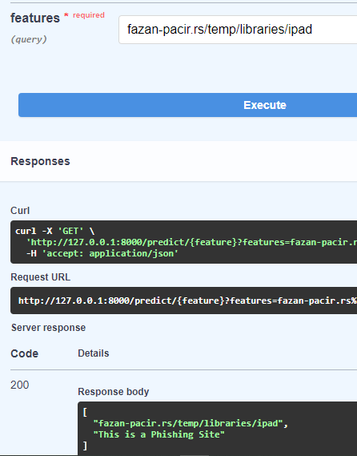
Deployment on fastApi
Input
Output

Slide 22
Future Work
Classification algorithm like Random forest can be tried by manipulating dataset weight.
A hybrid model can be implemented by adding different features.

Slide 23
Conclusion
Logistic Regression giving the better accuracy than other algorithms.
Now the model is ready for deployment
User can check any link whether it is phishing or not.

Slide 24
References
Anti-Phishing Working Group (APWG): Phishing activity trends report—last quarter- https://apwg.org/trendsreports/
Parvathy R. “Phishing Website Detection Using Machine Learning Algorithms” Proceedings of the National Conference on Emerging Computer Applications (NCECA)-2022
Ebubekir Buber, Banu Diri, Ozgur Koray Sahingoz et Al. “LP Based Phishing Attack Detection from URLs” Springer International Publishing AG, part of Springer Nature 2018 A. Abraham et al. (Eds.): ISDA 2017, AISC 736, pp. 608–618, 201810.
Rishikesh Mahajan, Irfan Siddavatam. “Phishing Website Detection using Machine Learning Algorithms” International Journal of Computer Applications (0975 – 8887)Dutta, A.K., 2021. Detecting phishing websites using machine learning technique. PloS one, 16(10), p.e0258361.

Slide 25

THANK YOU

